Slide 1
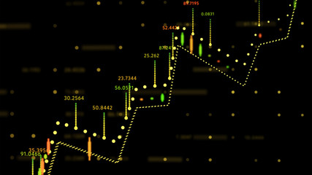


TIME SERIES PROJECT
Pooja Bera
Nataly Martínez Romero
Prajakta Digambar Sirame
Carolina Velásquez

Slide 2

INTRODUCTION
ARIMA Models
Exponential smoothing methods are useful for making forecasts and make no assumptions about the correlations between successive values of the time series. However, if you want to make prediction intervals for forecasts made using exponential smoothing methods, the prediction intervals require that the forecast errors are uncorrelated and are normally distributed with mean zero and constant variance.
Since we need to find the difference of the 1 year original time series data d times in order to obtain a stationary time series, this means that we can use an ARIMA(p,d,q) model, where d is the order of differencing used.

Slide 3

DATA COLLECTED
DATA COLLECTED FROM→ https://finance.yahoo.com/quote/ADMP/history?p=ADMP
Adamis Pharmaceuticals Corporation (ADMP)
NasdaqGS - NasdaqGS Real Time Price. Currency in USD
TECHNIQUE APPLIED→ ARIMA Models

Slide 4
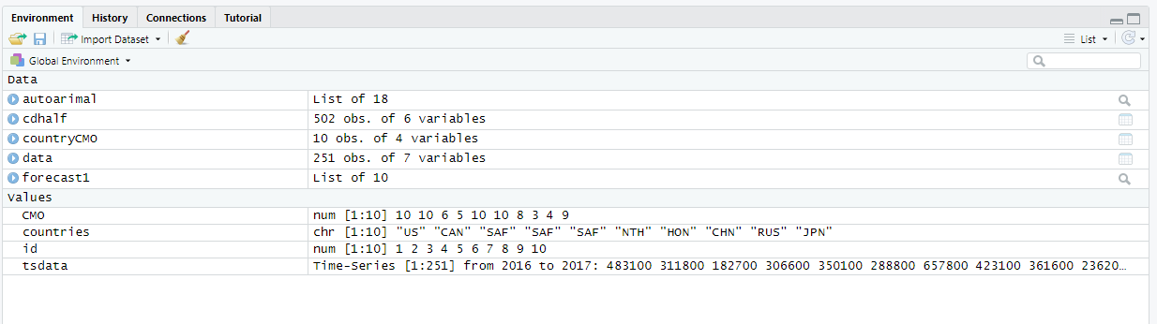
Global environment and values

Slide 5

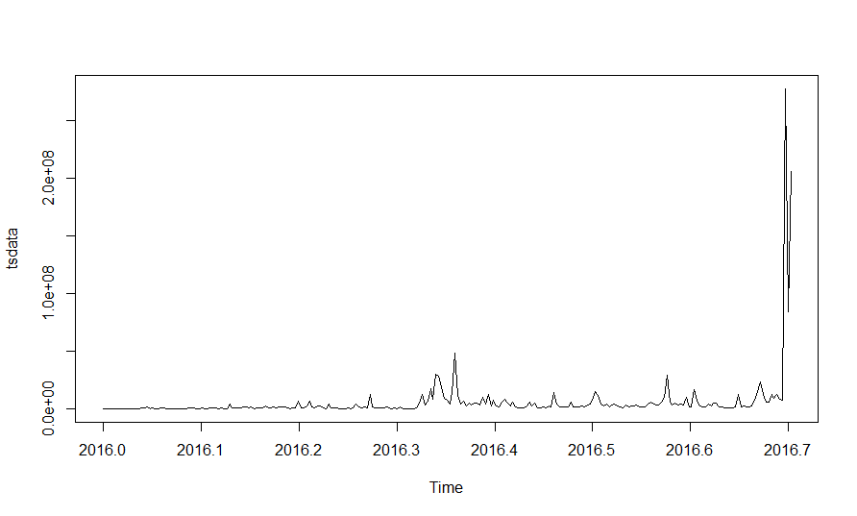
ADMP DATA VS TIME PERIOD
This graph represents the data we have used vs the time period i.e. 1 year(frequency =356,start=c(2016, 1)). From the time plot (above), we can see that the time series is not stationary in mean.

Slide 6

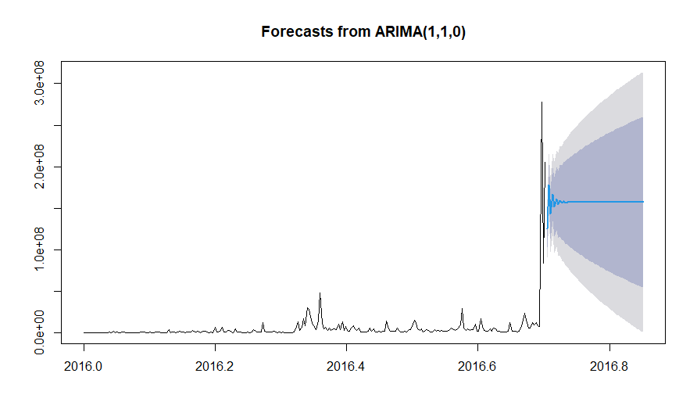
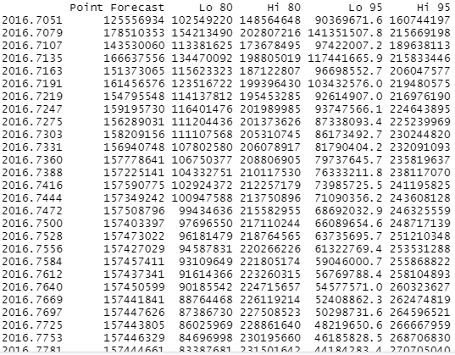
Forecast from ARIMA
This graph represents the forecast after applying ARIMA(1,1,0). The forecasts are shown as a blue line, with the 80% prediction intervals as an blue shaded area, and the 95% prediction intervals as a grey shaded area.

Slide 7
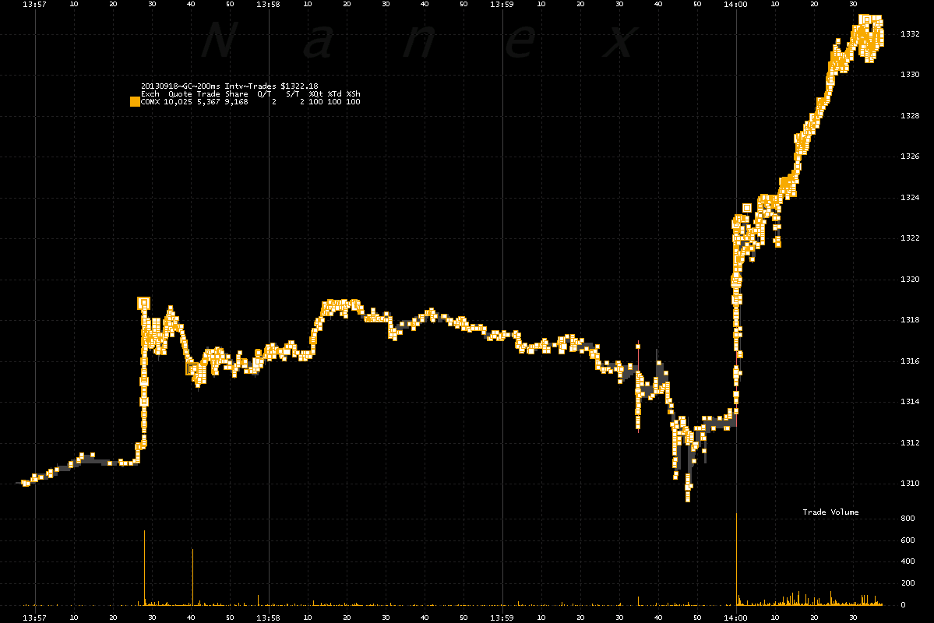
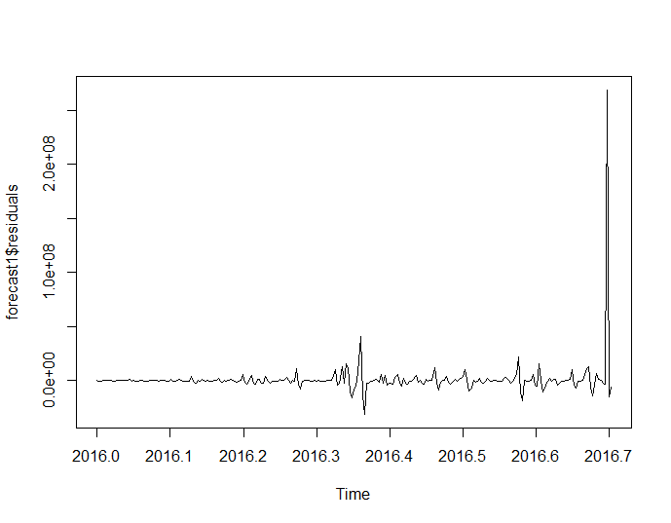
Forecast residuals
This graph represents the forecast residuals. We investigate whether the forecast errors seem to be correlated, and whether they are normally distributed with mean zero and constant variance.

Slide 8
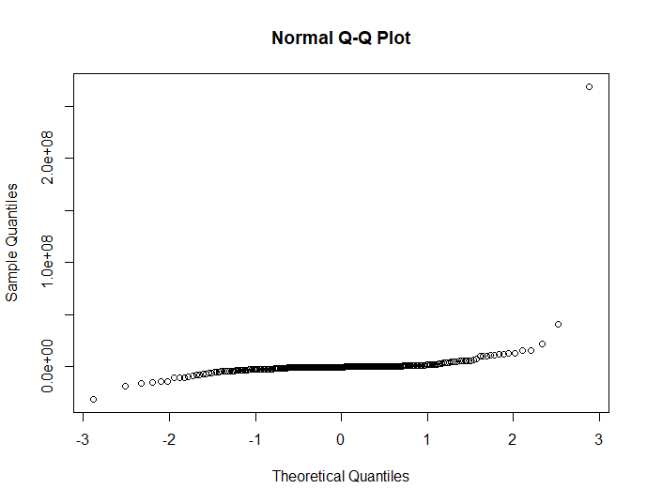
NORMAL Q-Q plot
This graph represents the normal Q-Q plot. The theoretical quantiles are taken against the sample quantiles.

Slide 9

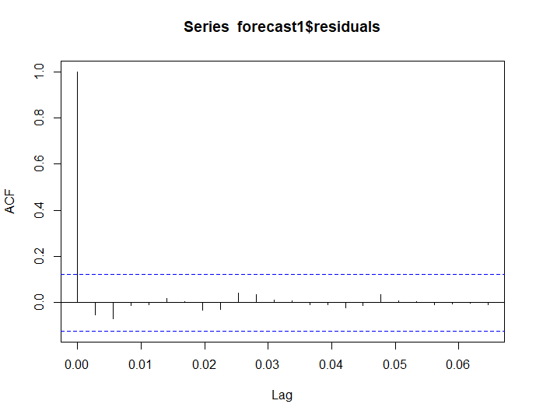
ACF
This graph represents the ACF plot. Here the correlogram shows that the sample autocorrelation for the in-sample forecast errors. Since correlogram shows that none of the sample auto-correlations for lag l-0.06 exceed the significant bound ,we can conclude that there is very little evidence for non-zero autocorrelation .

Slide 10

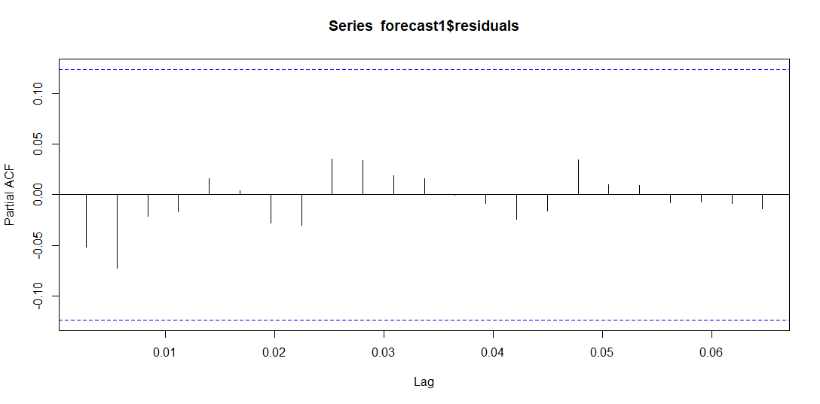
PARTIAL ACF
This graph represents the partial ACF plot. Here the correlogram shows that the sample autocorrelation for the in-sample forecast errors no lag exceeds the significance bounds.

Slide 11
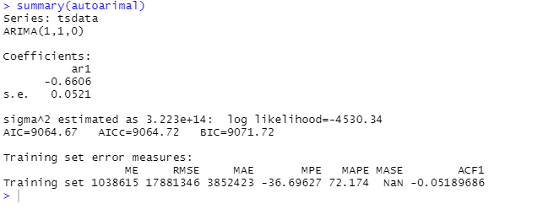
AUTOARIMA SUMMARY
The above is the method 1 Summary of the ARIMA technique is applied which clearly depicts we have an accuracy of 72.174(MAPE) with the taken training set ADMP data.

Slide 12
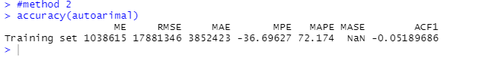
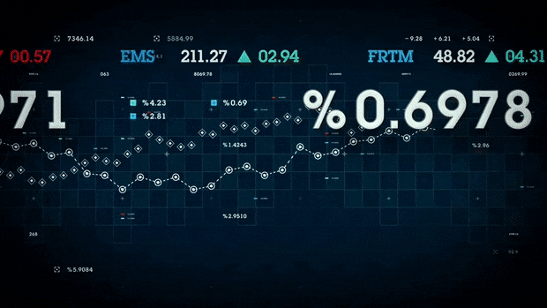
ARIMA ACCURACY
The above is the method 2 we applied for the accuracy in which the ARIMA technique is applied which clearly depicts we have an accuracy of 72.174(MAPE) with the taken training set ADMP data.

Slide 13

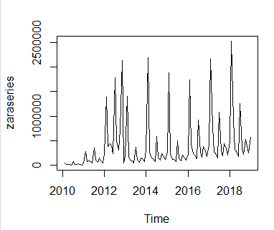
Zara Spain
Sales data from 2010 to 2019
zaraseries <- ts(zara, frequency=12, start=c(2010,2))
Notes:
The first think that we did was that we read the data from the Excel document using the function read_Excel. The we transforme the data to time series useing the ts () function and we plot. As the data was in a monthly basis we used the frecuency=12

Slide 14

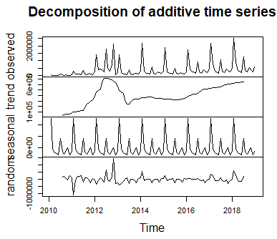
Decomposition
We decompose the series to understand the different components
Trend
Seasonal
Residual
Notes:
We decided to decompose the time serie to obtain it’s different components. For that we used the función decompose(). We can see that the estimated tren shows a decrease beteen 2012 and 2012. followe by a increse from that pointt until 2019 that where we have the data

Slide 15

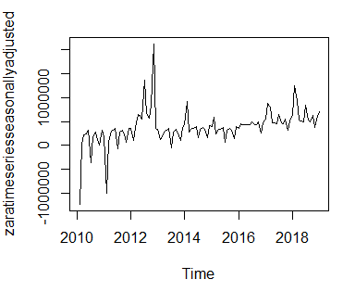
Seasonal Adjusting
We extract the seasonal component from the original series to adjust the time series
Notes:
We adjust the time series by estimating the seasonal component and substracting it from the original . And we plot the function . We can see that the seasonal variation has been removed and it still contains the tren

Slide 16

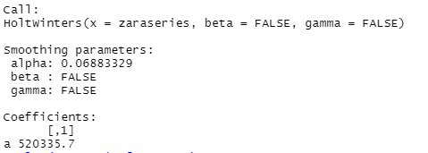
Forecast using exponential smoothing
We are going to forecasts Zara sales using exponencial smoothing, using the original data,
Notes:
We decided to use exponenecial smoothing eventhough we now there is seasonality to show the forecast that we may obtain using not an acurate model. As Alpha is close to 0 it means that the Little weight is placed in the most recent observations when making a forecast of future values

Slide 17

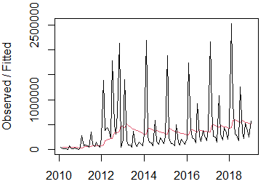
Forecast
Notes:
We plot the original series vs the forecast typping. The time series forecast is much smoother that the original data

Slide 18

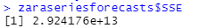
accuracy
The sum-of-squared-errors is 2.924174e+13
Notes:
As a measure of the accuracy of the forecasts, we can calculate the sum of squared errors for the in-sample forecast errors, that is, the forecast errors for the time period covered by our original time series. The sum-of-squared-errors is stored in a named element of the list variable “rainseriesforecasts” called “SSE”,

Slide 19
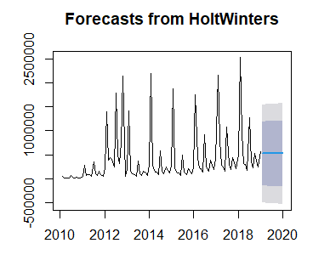
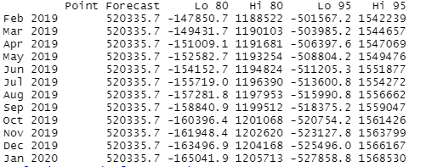
Forecast 2

Slide 20

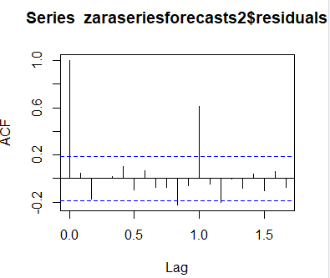
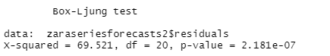
Testing my model 1/2
Correlogram of the in-sample forecast errors
Ljung-Box test

Slide 21
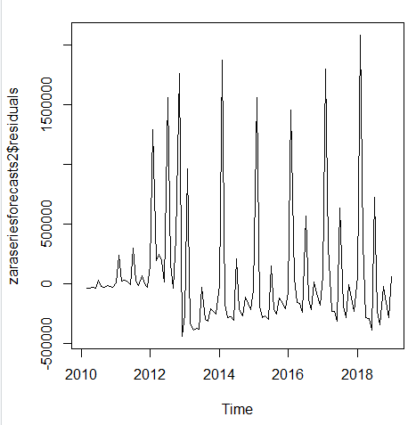
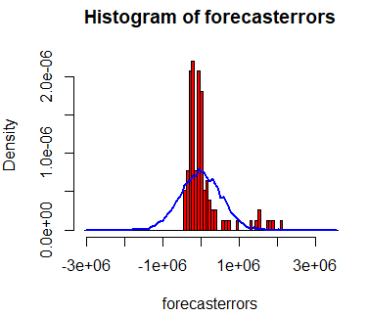
Testing my model 2/2
In-sample forecast errors
Histogram

Slide 22

Conclusions
The histogram shows that the errors are not normally distributed, since there is no left skew.
The ljung-box test indicates the possibility of non-zero autocorrelation within the first 20 lags.
It is suggested that the simple exponential method does not provide a suitable model for Zara Spain.
It was expected because of the seasonality observed in Zara Data

Slide 23
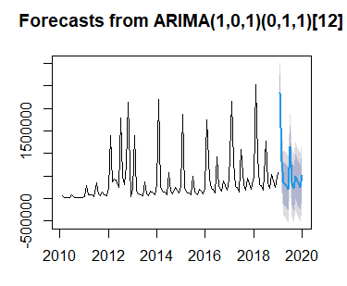
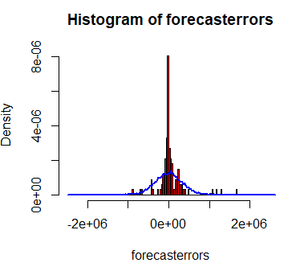
Zara arima

Slide 24


Thank you

